Slide 1
Summary of the Neural Network Course
Presenter：LIU JIAHE
Group Members：LIU JIAHE，Ken Sato，Keisuke Utsumi
May 5,2023

Slide 2
1
Step and sigmoid function
2
4-bit parity check problem
3
Hopfield network
CONTENTS
4
WTA
5
SOFM
May 5,2023

Slide 3
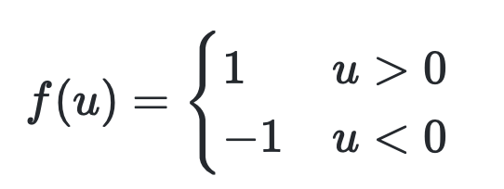
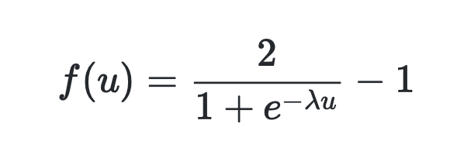
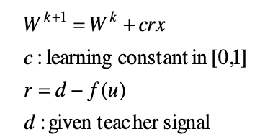
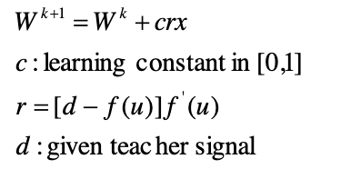
Project 1
Initialize weights
Find the output
Weight update
Update the total error
The perceptron learning rule
The delta learning rule

Slide 4
Project 1
The perceptron learning rule:
Error in the 1-th learning, Neuron output for each input pattern= -1.000000 1.000000 -1.000000 -1.000000
:
:
Error in the 6-th learning, Neuron output for each input pattern= -1.000000 -1.000000 -1.000000 1.000000
The delta learning rule:
Error in the 1-th learning, Neuron output for each input pattern= -0.137264 -0.087140 0.066323 -0.154400
Error in the 2-th learning, Neuron output for each input pattern= -0.335516 -0.234115 -0.081287 -0.212619
:
:
Error in the 970-th learning, Neuron output for each input pattern= -0.999850 -0.923421 -0.923368 0.909036
Error in the 971-th learning, Neuron output for each input pattern= -0.999850 -0.923462 -0.923410 0.909085
The perceptron learning rule:
Error in the 1-th learning cycle=8.000000
Error in the 2-th learning cycle=4.000000
Error in the 3-th learning cycle=0.000000
The delta learning rule:
Error in the 1-th learning cycle=4.391804
Error in the 2-th learning cycle=3.647490
Error in the 3-th learning cycle=1.944532
Error in the 4-th learning cycle=1.882734
Error in the 5-th learning cycle=3.397979
Error in the 6-th learning cycle=1.396447
Error in the 7-th learning cycle=1.972744
Error in the 8-th learning cycle=1.959355
Error in the 9-th learning cycle=1.926832
Error in the 10-th learning cycle=1.798133
Error in the 11-th learning cycle=2.503469
Error in the 12-th learning cycle=1.791384
Error in the 13-th learning cycle=0.030948
We found that step function to output values and it takes only -1 and 1. So final results are exactly same as expected outputs.
Sigmoid function to output values and it takes continuous value [-1, 1]. And the number of cycles is quite huge comparing with perceptron leaning rule. Its results are not same as expected results exactly, but close to the teacher label.
Notes:
Perceptron learning rule
Perceptron learning ends with 0 error in this problem. Because it uses step function to output values and it takes only -1 and 1. So final results are exactly same as expected outputs.
Delta learning rule
Delta learning ends with non 0 error in this problem. Because it uses sigmoid function to output values and it takes continuous value [-1, 1]. And the number of cycles is quite huge comparing with perceptron leaning rule. Its results are not same as expected results exactly, but so close.

Slide 5
02. 4-bit parity check

Slide 6
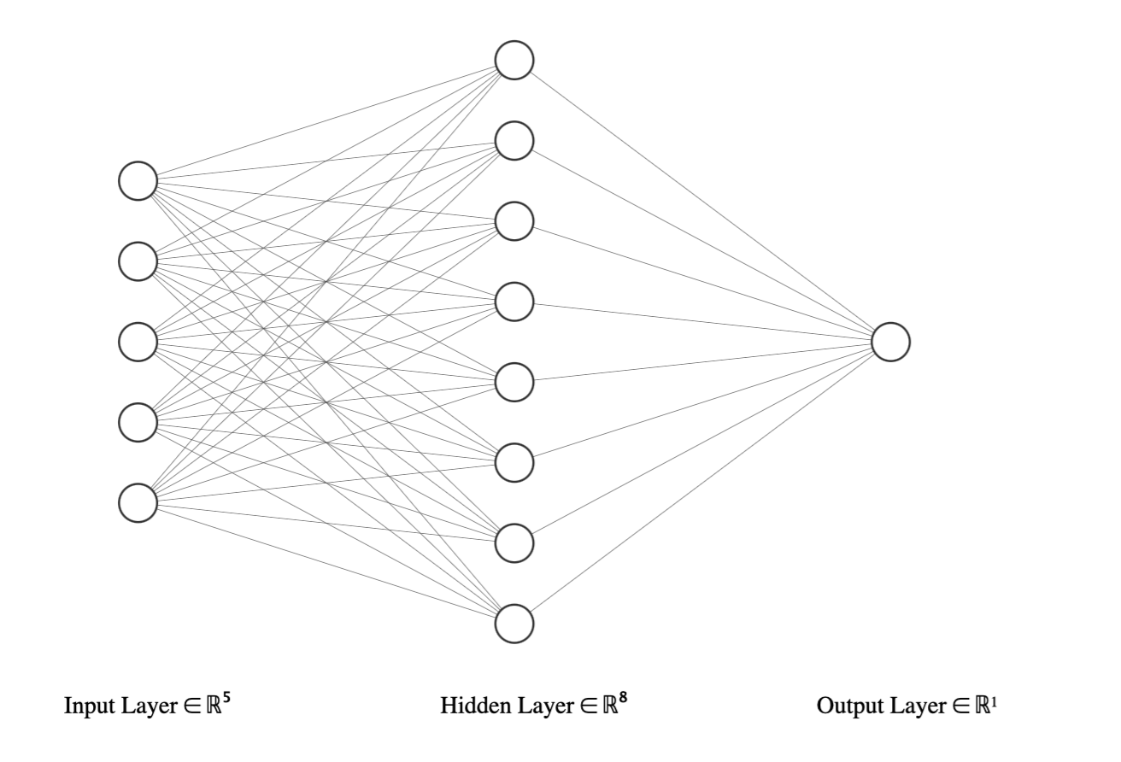
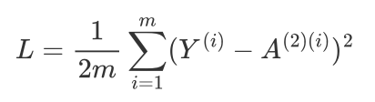
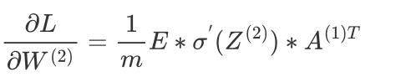
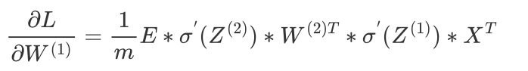
The problem is to input a 4-bit number (0 or 1) and output 1 if the number of 1 is even, and 0 otherwise.
For example:
(0, 0, 0, 0, -1) -> 1
(0, 1, 1, 1, -1) -> 0
(1, 0, 0, 1, -1) -> 1
(1, 0, 1, 1, -1) -> 0
Adjust the learning rate and the number of neurons in the hidden layers to reduce the value of the mean square error loss function while also attempting to improve the accuracy of the outputs.
Use the matrix form of the backpropagation algorithm to update the weights.

Slide 7
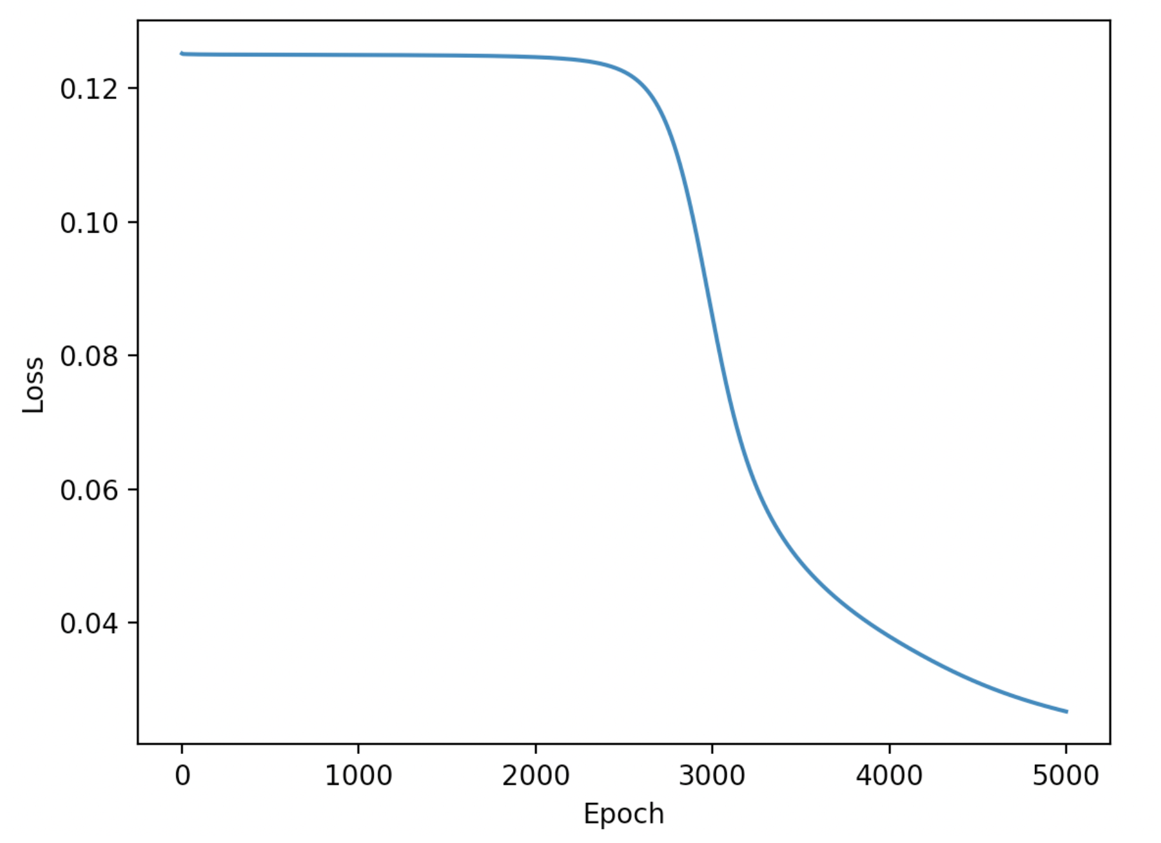
hidden_neurons = 8
learning_rate = 2
num_epochs = 5000
The loss value drops significantly at a certain stage, indicating that the model has learned the pattern between the data.
Then, the program will output the weight matrix of the model.

Slide 8
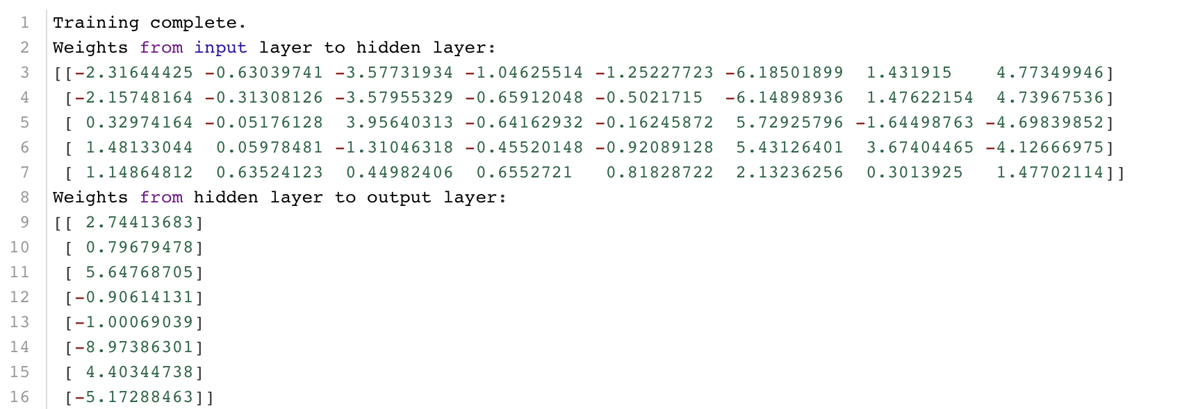
Use these above trained weight to test the model

Slide 9
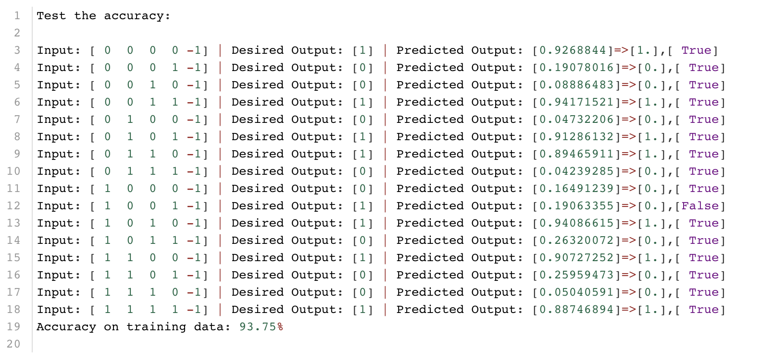

Slide 10
Use the following different parameter combinations to find the most suitable one.
learning_rates = [0.5, 1.0, 1.5, 2, 2.5, 3.0]
hidden_neurons_list = [4, 6, 8, 10, 12, 14]
num_epochs = 10000

Slide 11
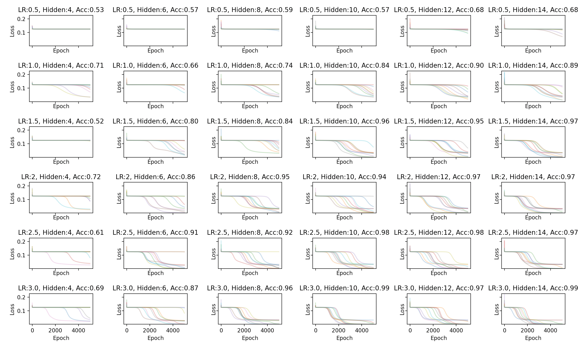
Use the following different parameter combinations to find the most suitable one.
learning_rates = [0.5, 1.0, 1.5, 2, 2.5, 3.0]
hidden_neurons_list = [4, 6, 8, 10, 12, 14]
num_epochs = 10000

Slide 12
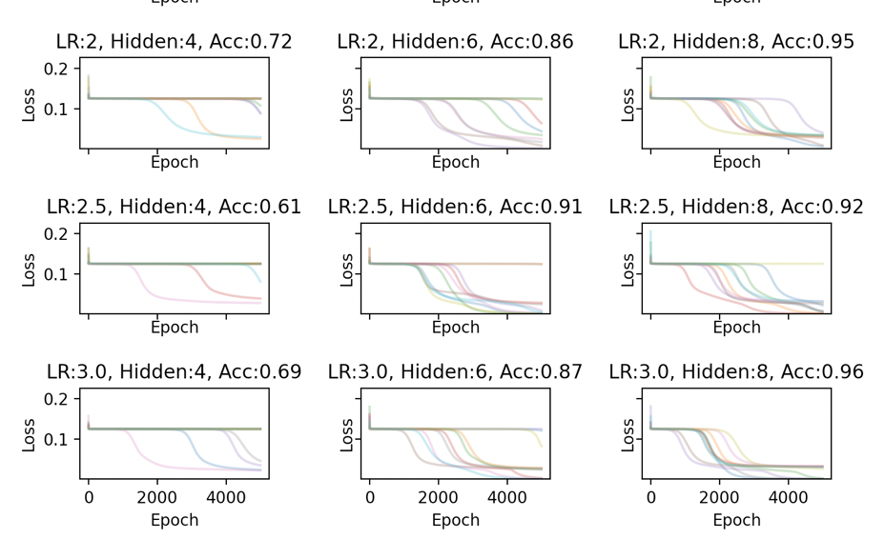
When the loss function value is 0.125 or 0.03, it remains almost stable without decreasing for a long period of epochs.
The reason is that when the loss function is equal to these two values, the neural network enters a phase of local optimal solution ,in this situation, the gradient is small, the weight update is slow.
Continuing training, the neural network jumps out of the local optimal solution, the gradient increases, the weight starts to update, and the loss function continues to decrease.

Slide 13
03. Hopfield network

Slide 14
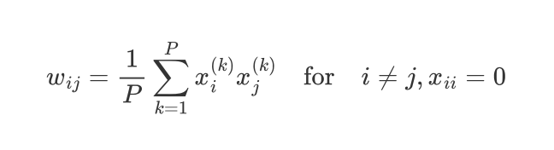
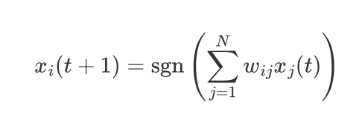
The main purpose of the Hopfield network is to store and retrieve patterns or memories in a distributed manner. It can be used to recognize and recall previously learned patterns even if they are corrupted or incomplete.
Store patterns(Generate weight matrix):
Recall(Retrieving memorized patterns. )

Slide 15
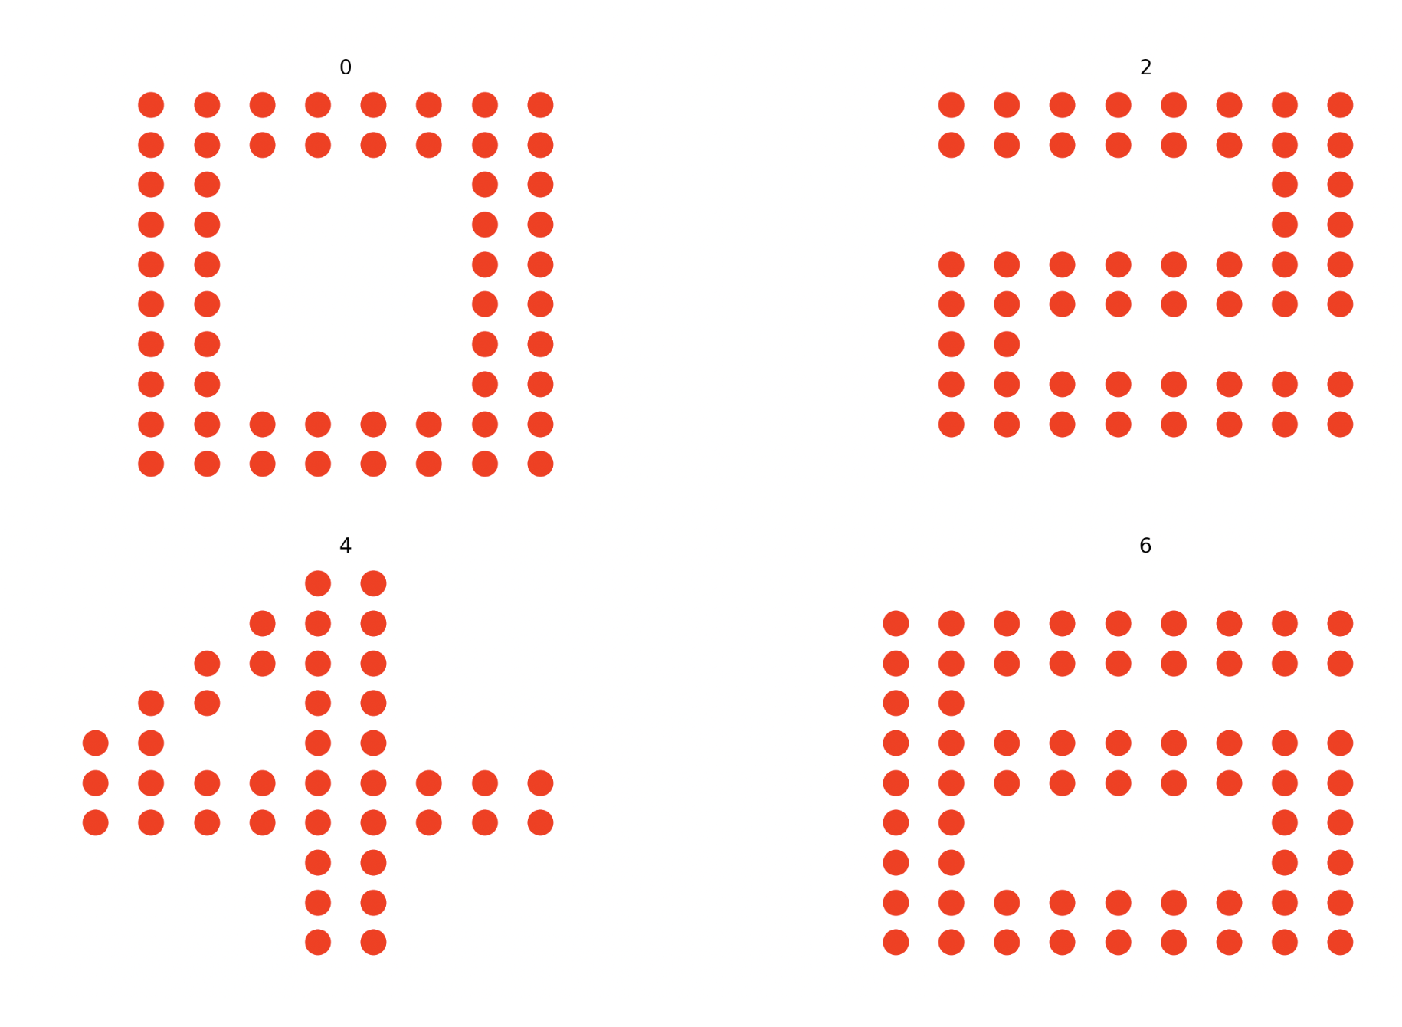
The original patterns are:

Slide 16
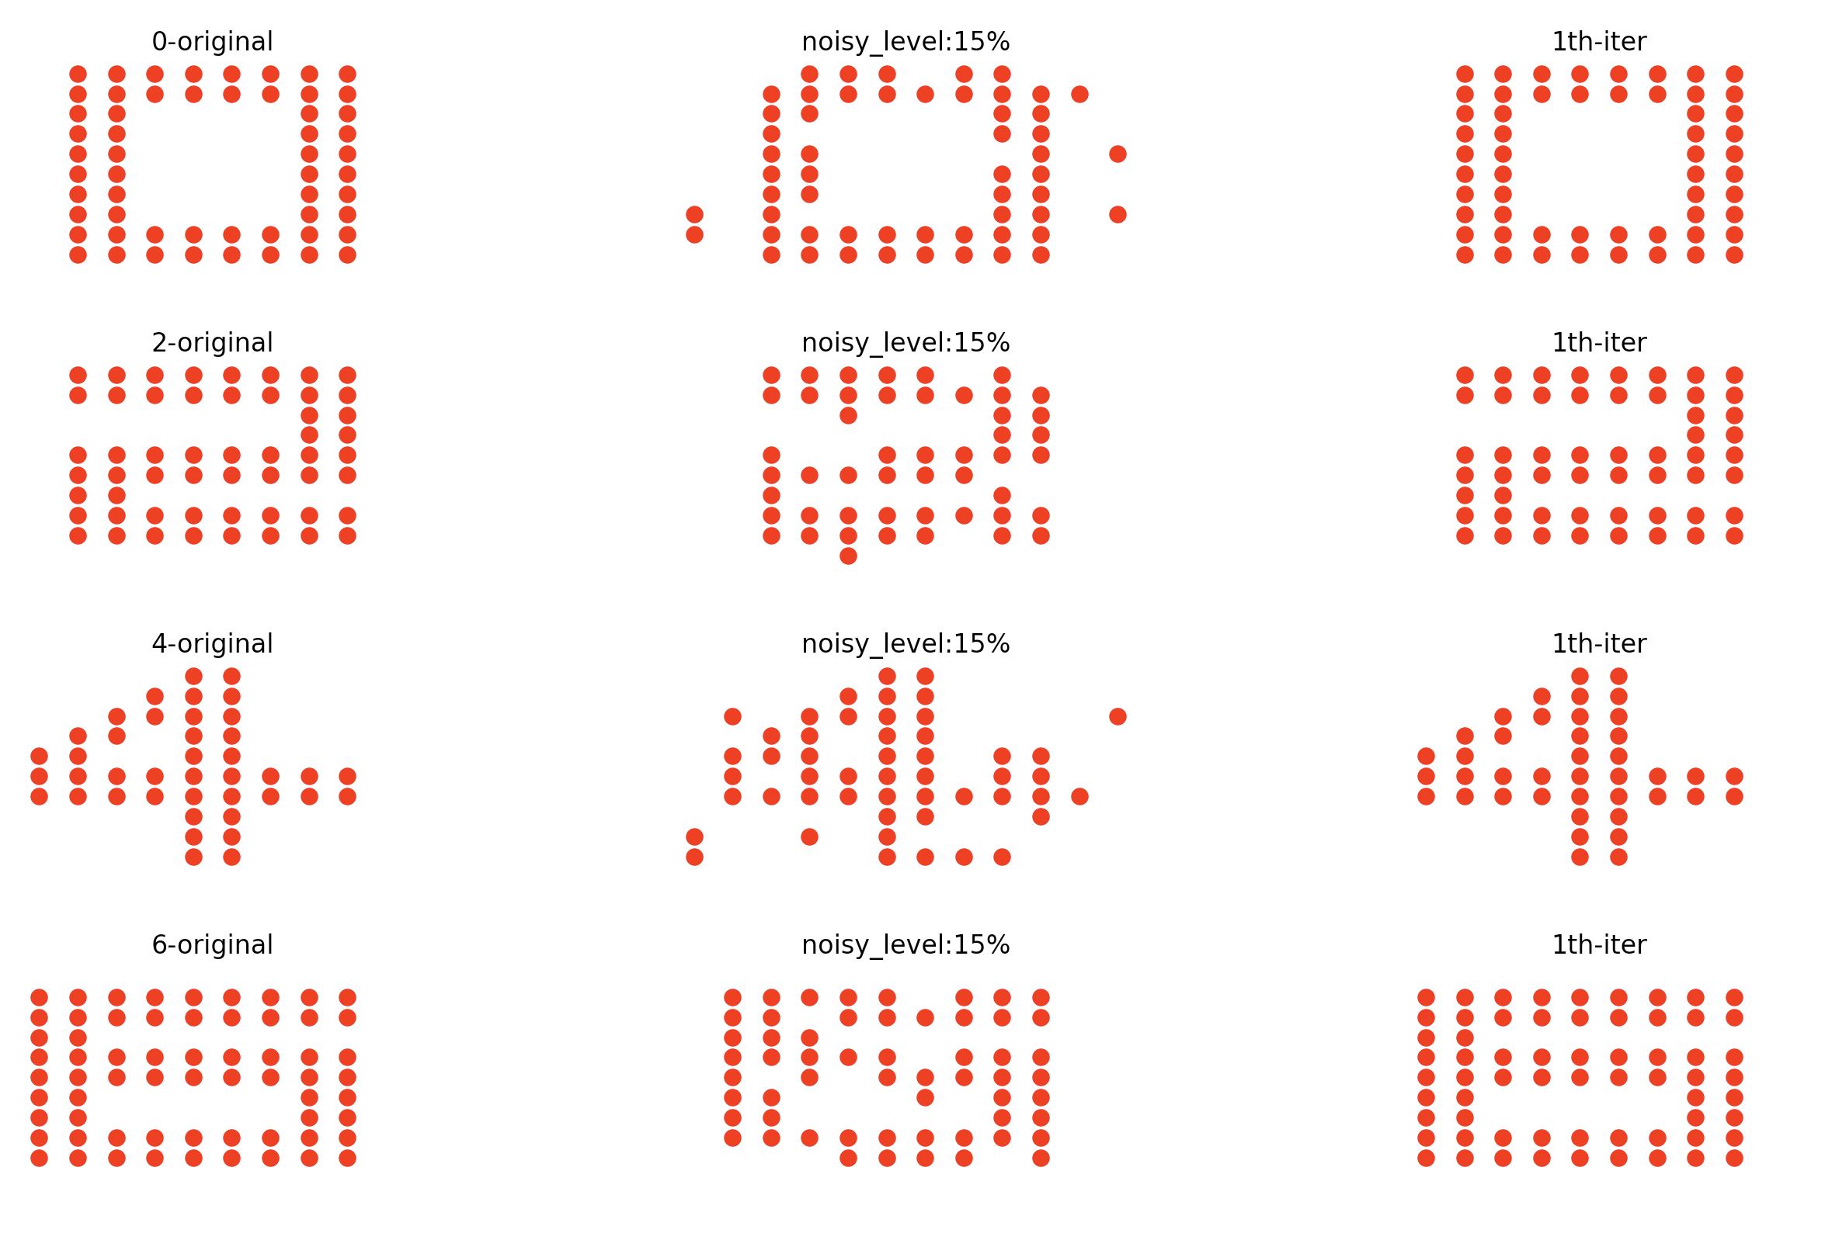
Test the memory capacity of the Hopfield network at noise levels of 10%, 15%, 20%, 25%, 30%, respectively.

Slide 17
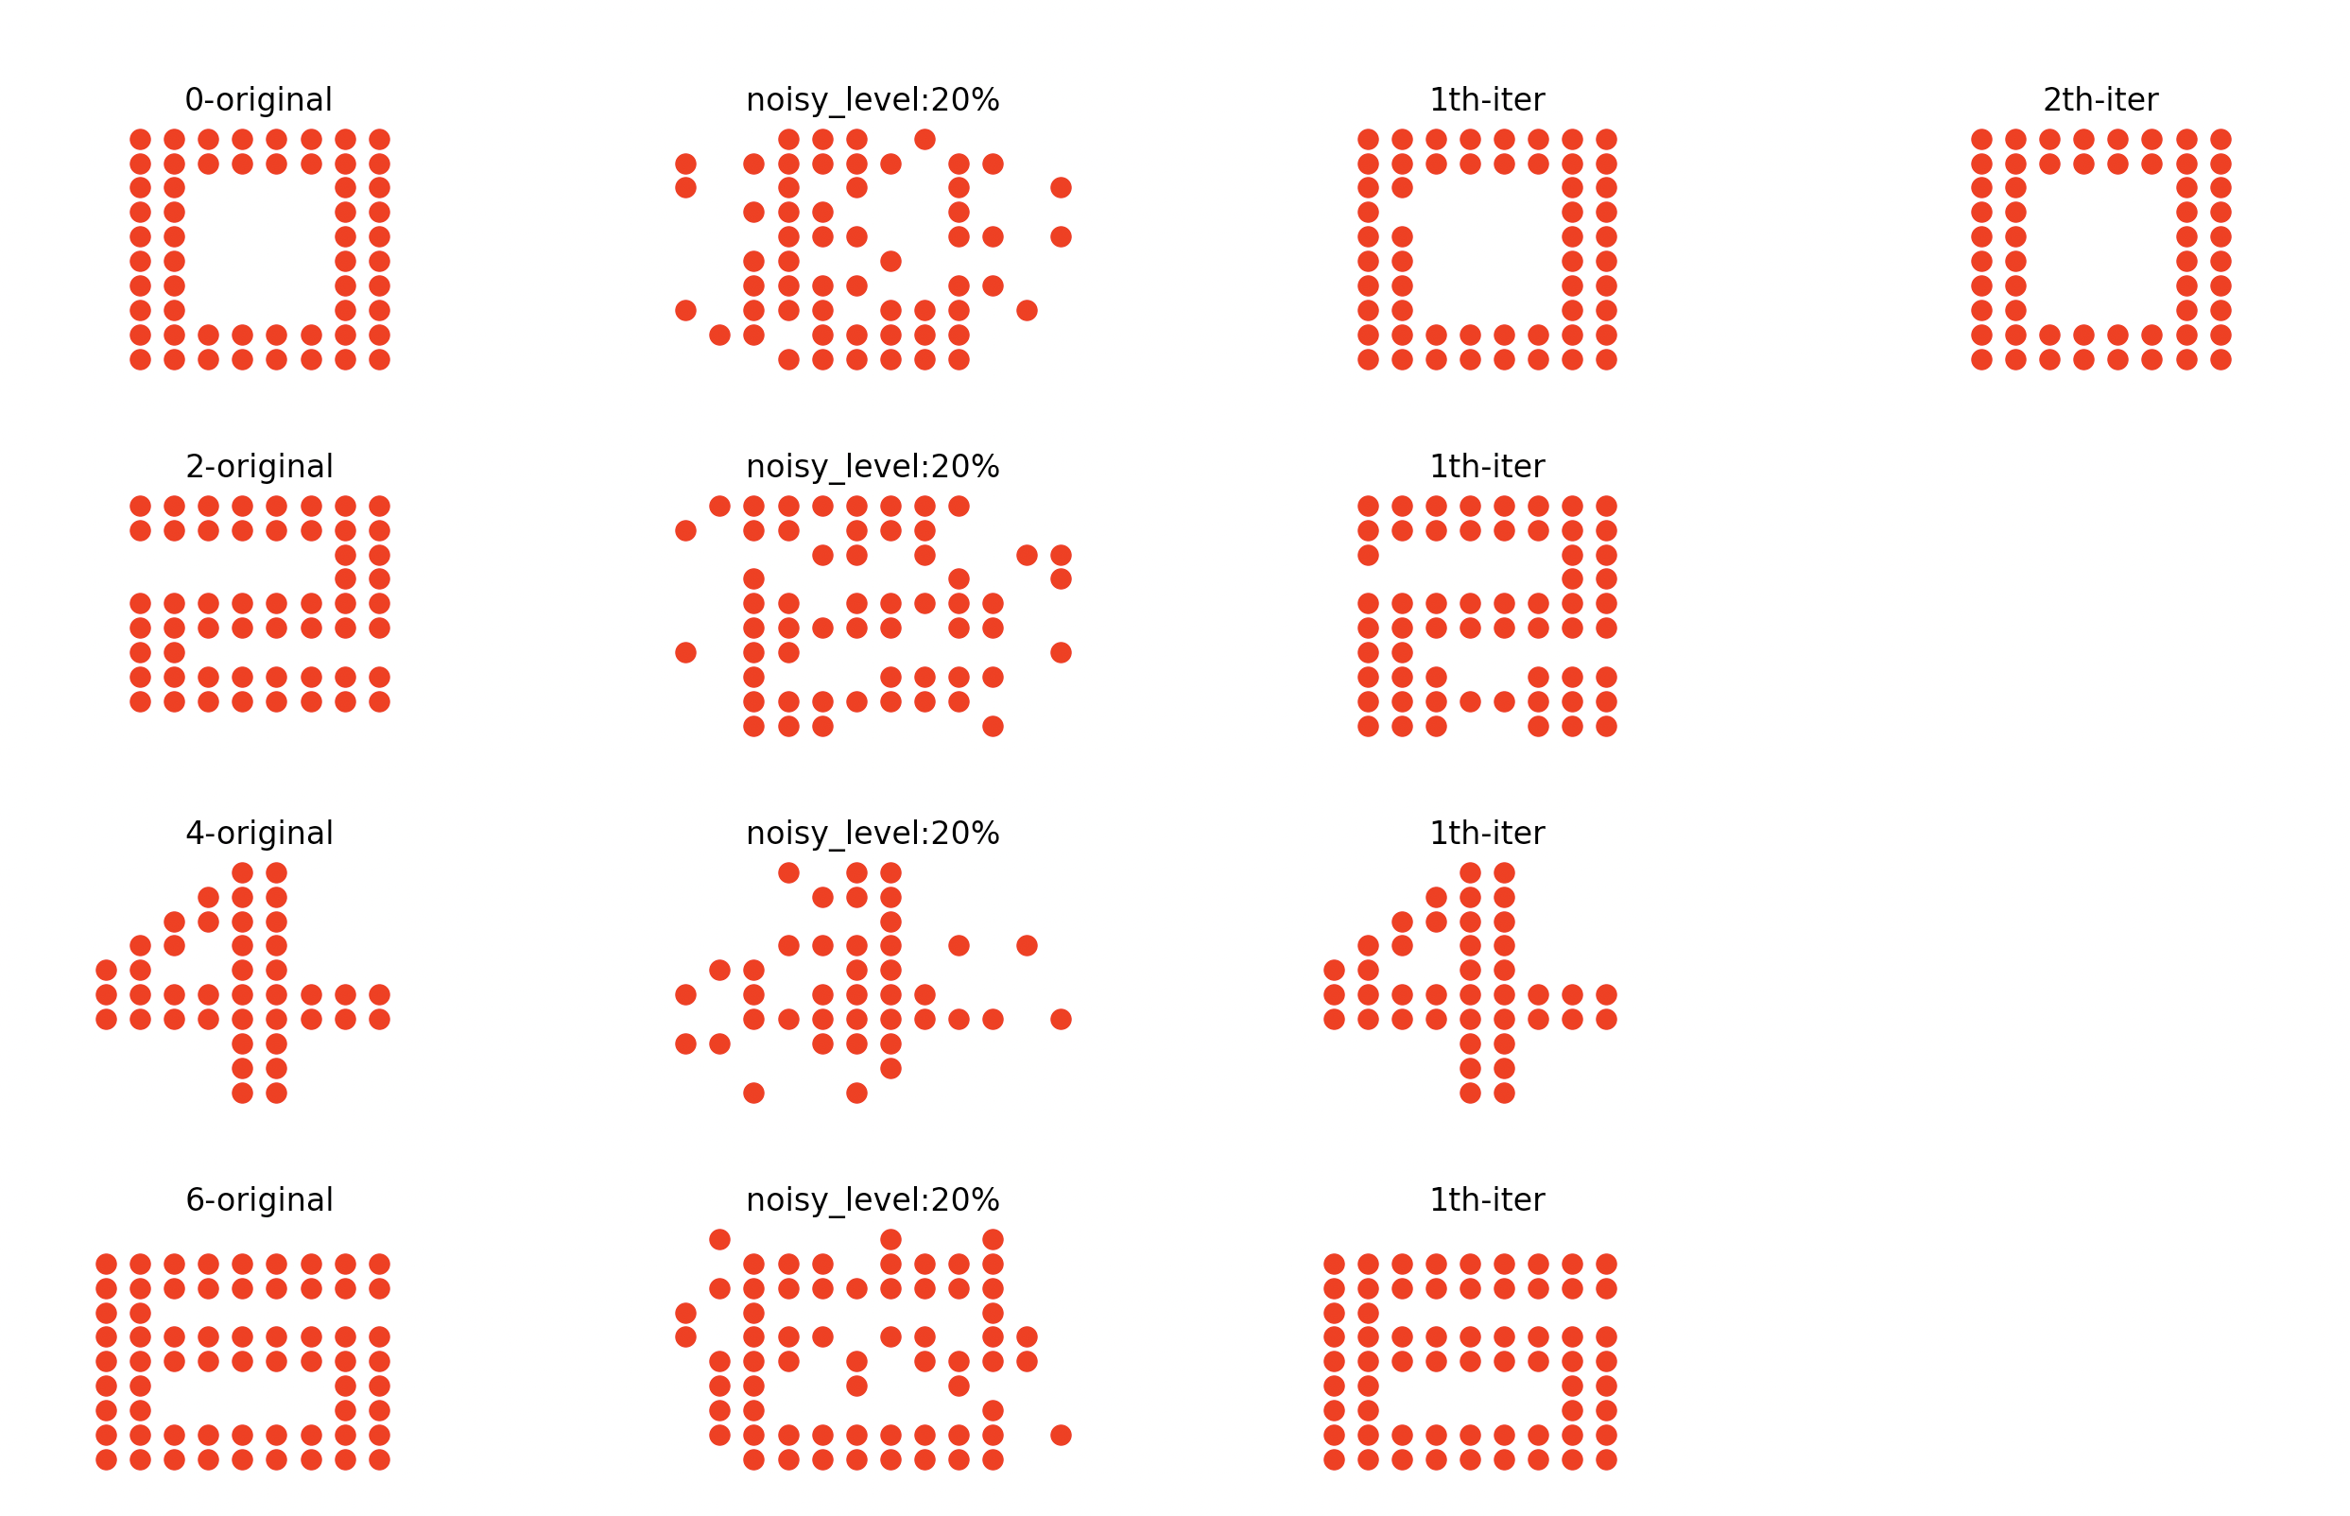

Slide 18
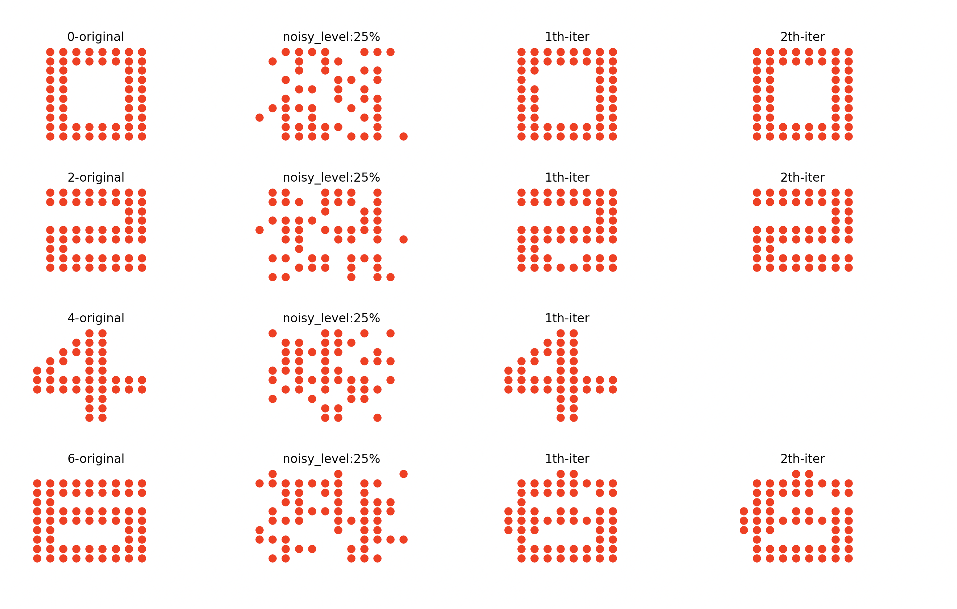

Slide 19
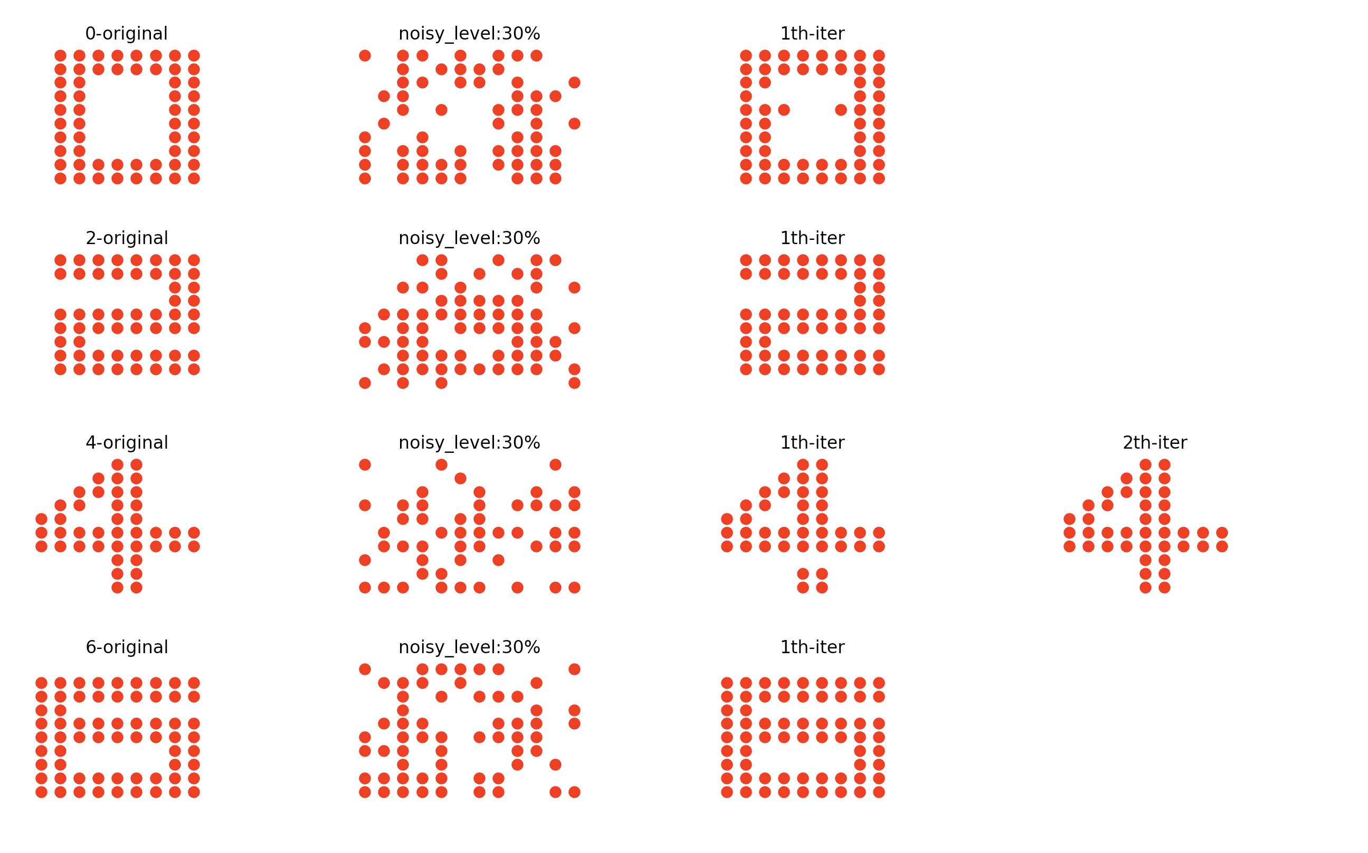

Slide 20
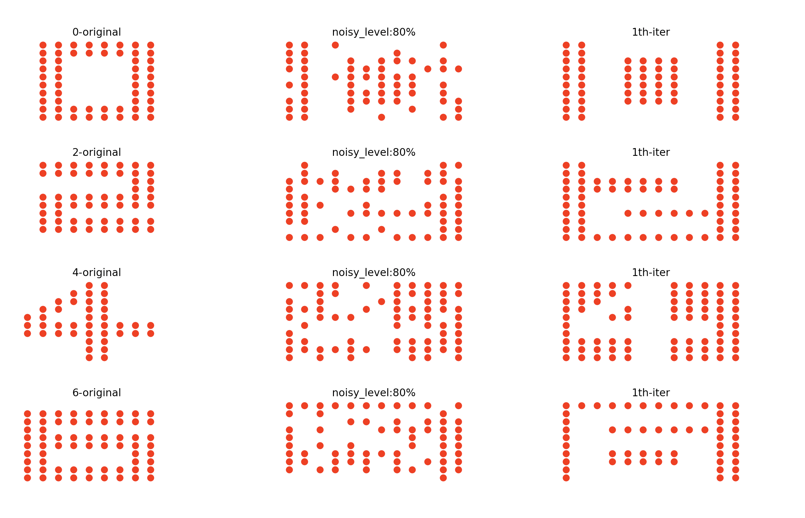
It can be observed that the restoration ability of the Hopfield network is quite good under a certain level of noise intensity. Furthermore, as we increase the noise level, we can discover interesting phenomena.
Initially, the pattern was composed of red dots. Now, the pattern is composed of white dots.
The memory of the Hopfield network has transformed a positive pattern into a negative pattern

Slide 21
Import numpy as np
n_neuron = 120
n_pattern = 4
w = np.zeros((n_neuron, n_neuron))
for key in original_patterns:
pattern = original_patterns[key]
for i in range(n_neuron):
for j in range(n_neuron):
w[i, j] += pattern[i] * pattern[j]
w = w/n_pattern
np.fill_diagonal(w, 0)
w = w.astype(int)
I would like to mention some issues with the code we found in project3. It is important to note that for weight matrix initialization, simply calculating the outer product and taking the average is not sufficient. It is crucial to round off all elements of the weight matrix to integers.
⭐️w = w.astype(int)

Slide 22
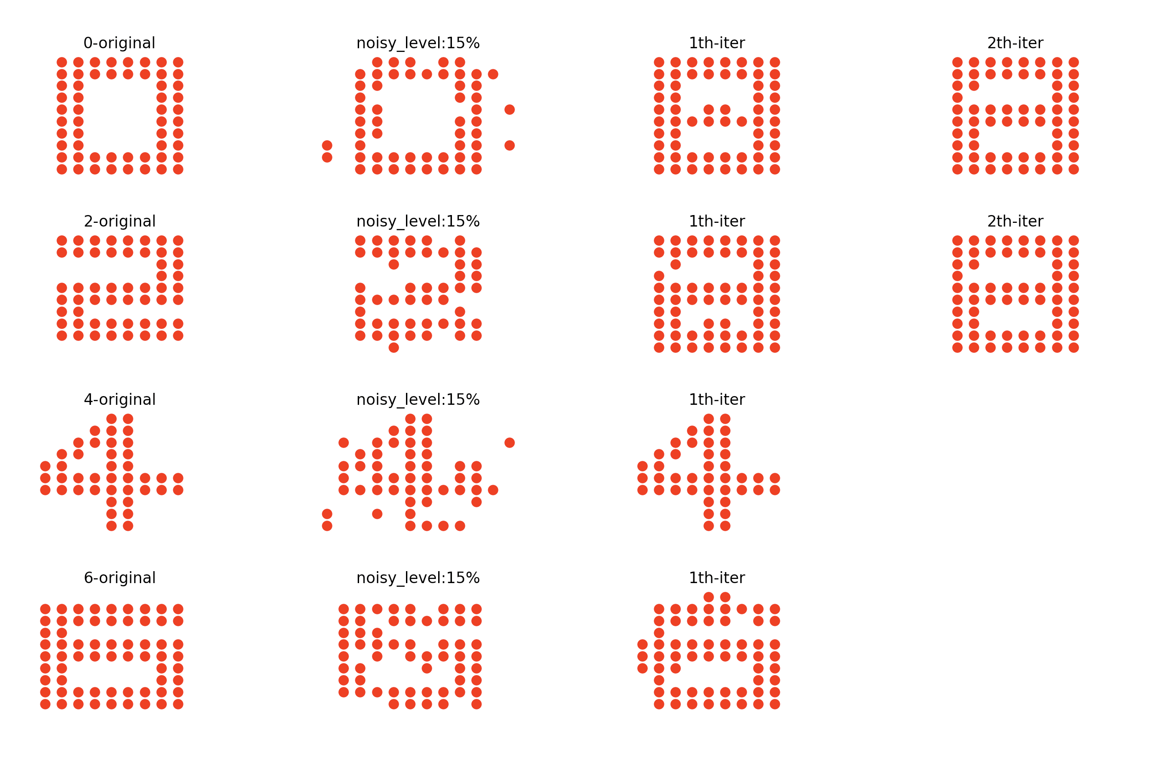
If we do not do that，the hopfield network can not recall correctly.
This is because the pattern is a binary pattern (-1, 1), thus the elements in the weight matrix need to be normalized to (-1, 0, 1). This helps to improve the performance of the network.

Slide 23
04. Winner-Take-All

Slide 24
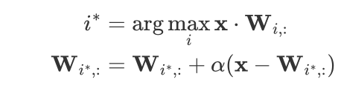
WTA (Winner-Take-All) is a competitive learning algorithm that only the winner (the neuron with the highest or lowest output) can be updated.
Update the weight matrix:
"i" represents the index of the neuron with the maximum dot product. From a vector perspective, the maximum dot product indicates W[i] has the same direaction with pattern i , which means are similar;
Direction of x-W[i] is from W pointing towards x, The basis for updating the weights is to make the direction of W[i] closer to the pattern i.

Slide 25
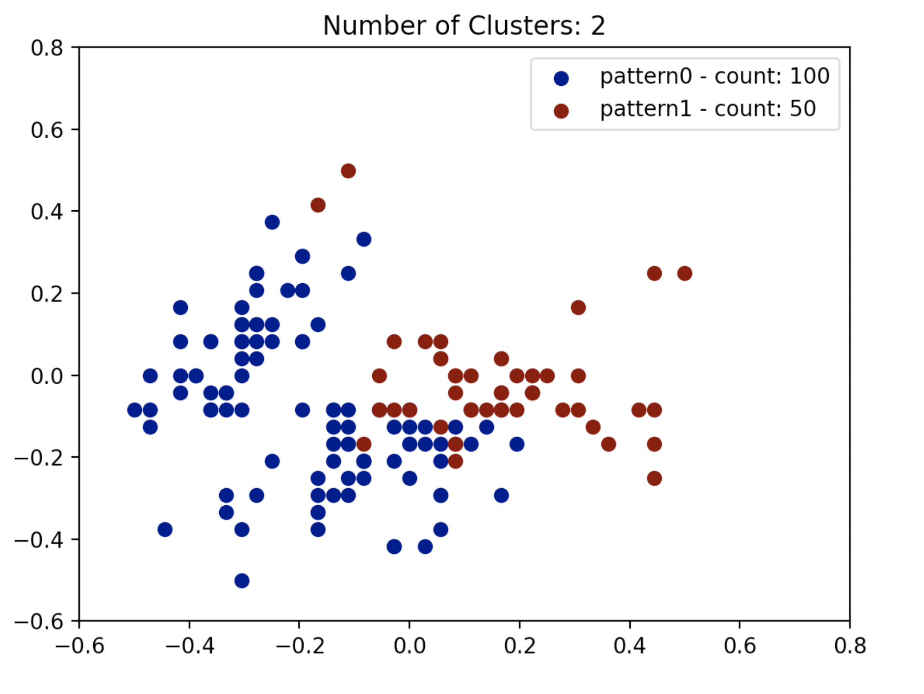
Next, we will perform clustering on the Iris dataset.
When the number of clusters is small, two-dimensional image is sufficient.
When the number of clusters is large, different classes may overlap in two-dimensional space. In such cases, use a three-dimensional image.

Slide 26
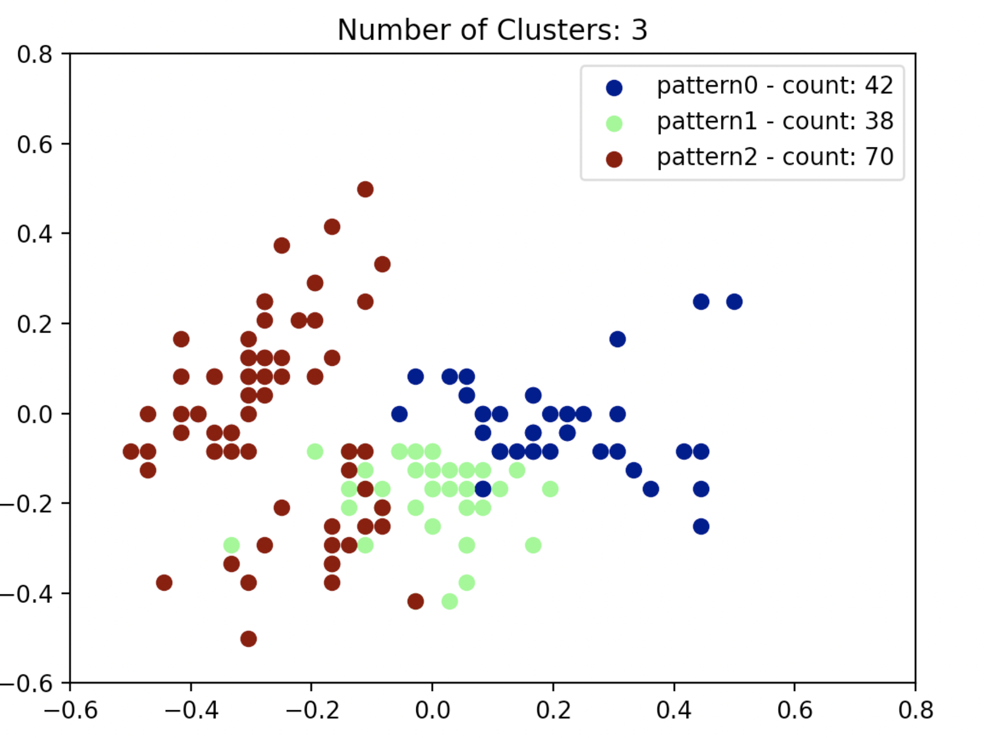

Slide 27
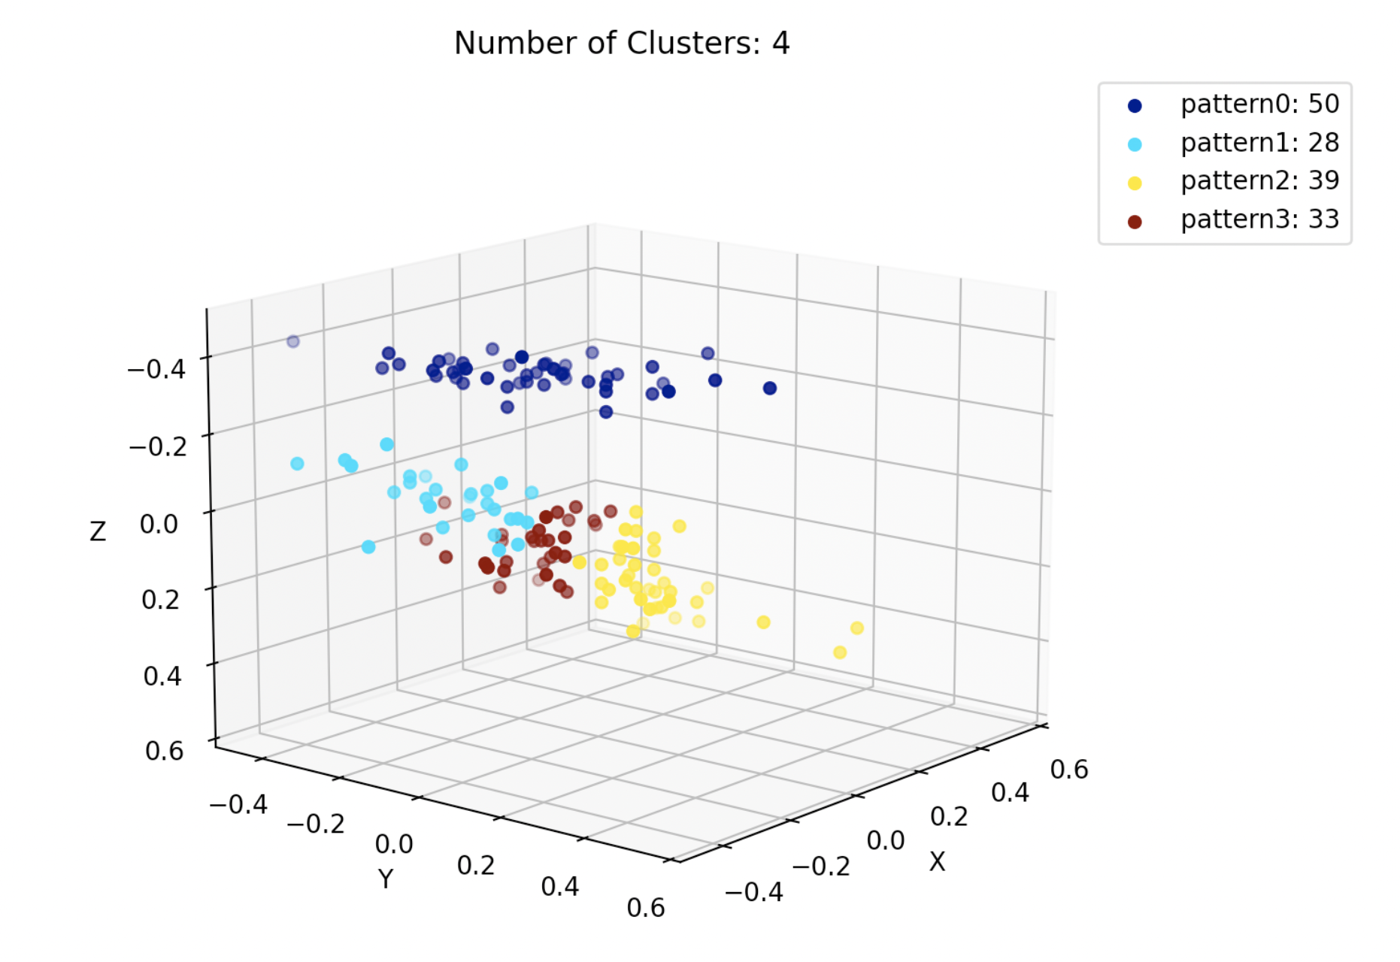

Slide 28
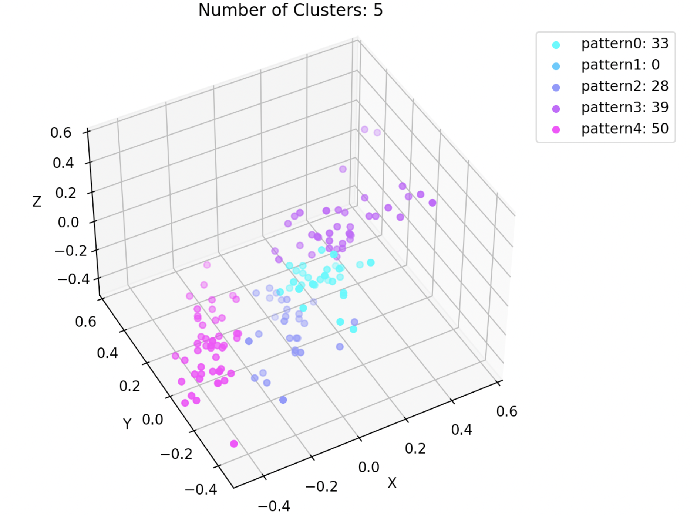

Slide 29
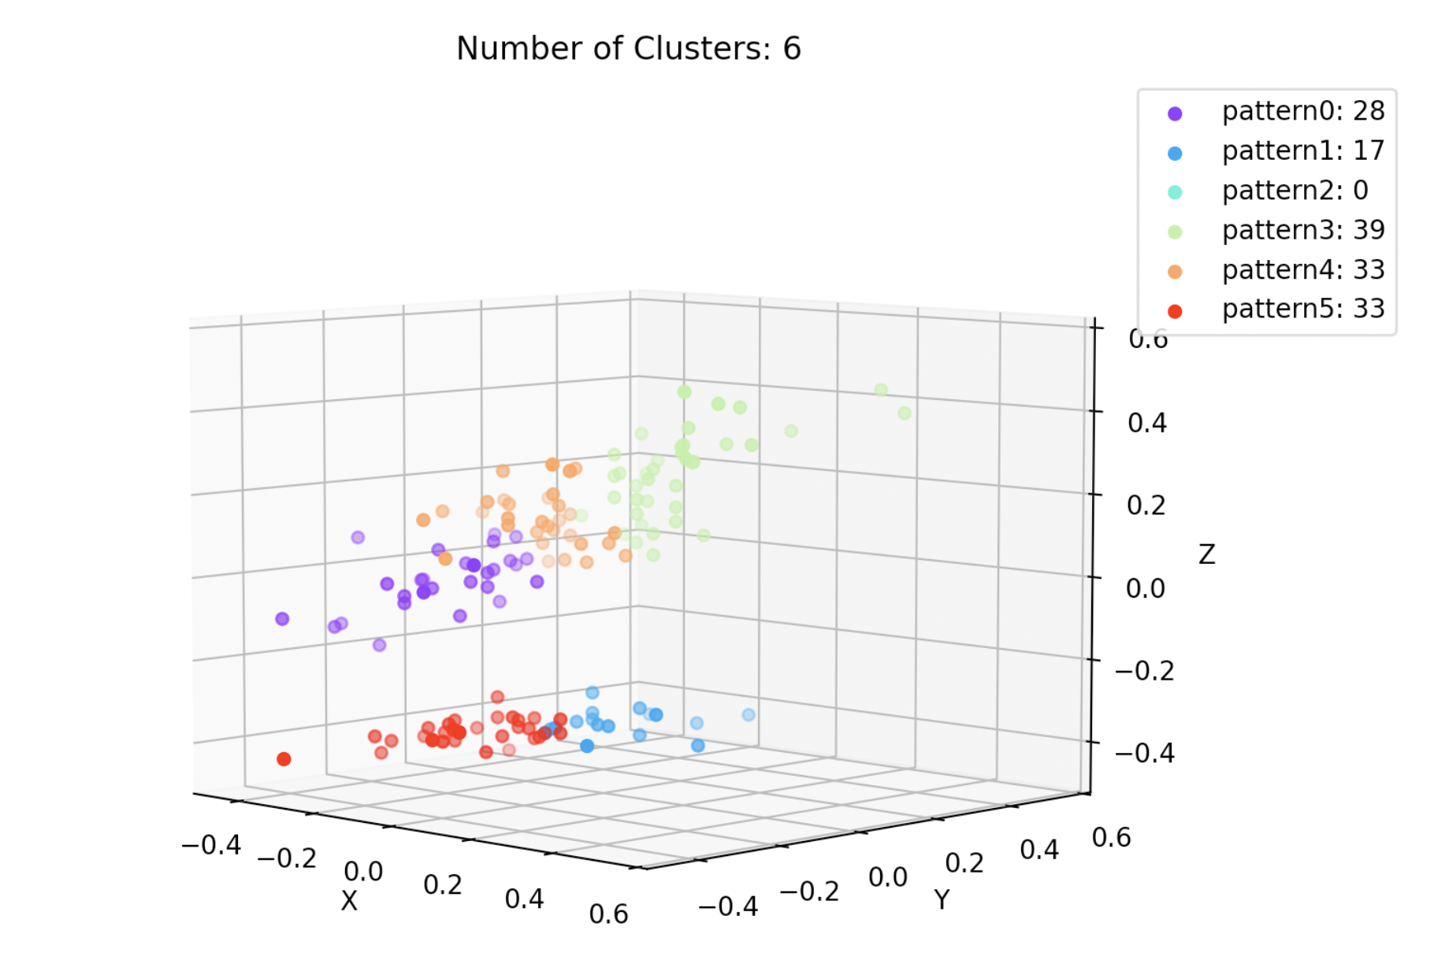

Slide 30
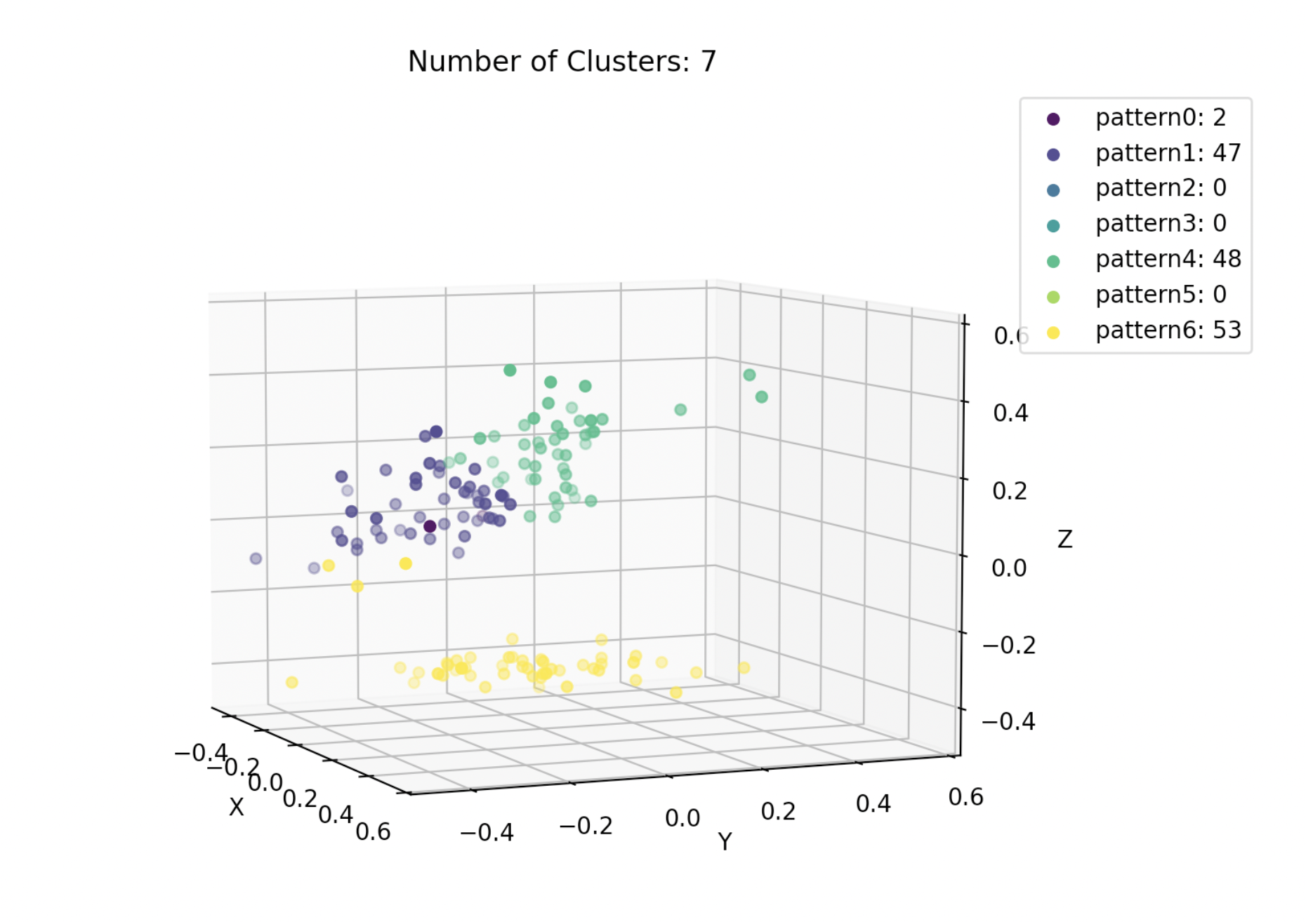

Slide 31
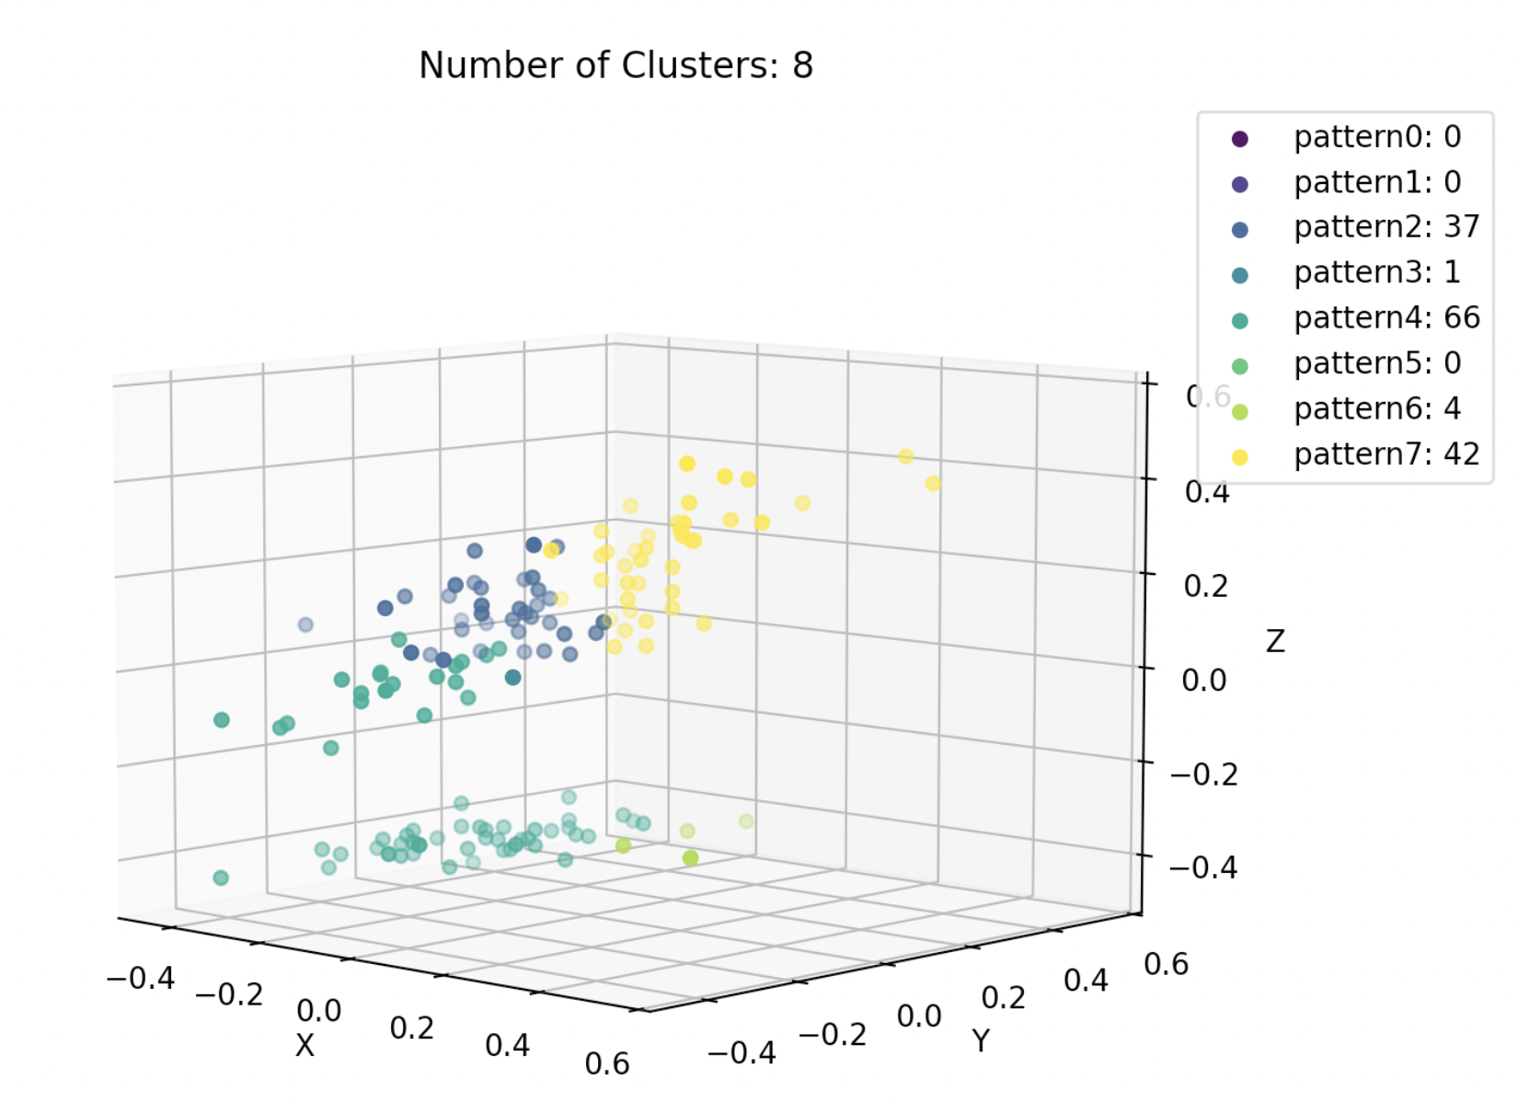
We notice that even as the number of 'n_clusters' increases, the actual number of types of classes doesn't increase.
That is, the real number of clusters in the data may be less than the number of clusters we set.
This indicates that the number of intrinsic distribution patterns in the Iris dataset is limited. Judging intuitively from the above images, the number of classes determined by the intrinsic data structure of Iris is probably between 2-5.

Slide 32
05. SOFM

Slide 33
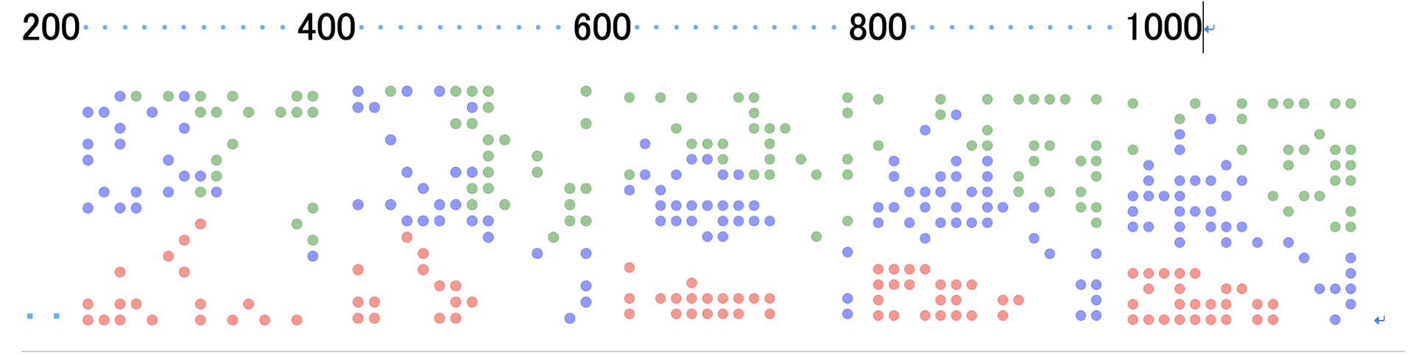
This network can reduce data length (data compression). It maps data into lower dimension with preserving neighborhood relation.
To visually demonstrate the process of the SOFM algorithm, we use the provided classification information within the iris dataset.
A----setosa-----red. B----versicolor----blue. C----virginica----green,
learning rate 0.5->0.0
neighborhood size 10->1
it can be observed that the distances between data of the same type become smaller and they tend to cluster together, while preserving the topological structure.

Slide 34
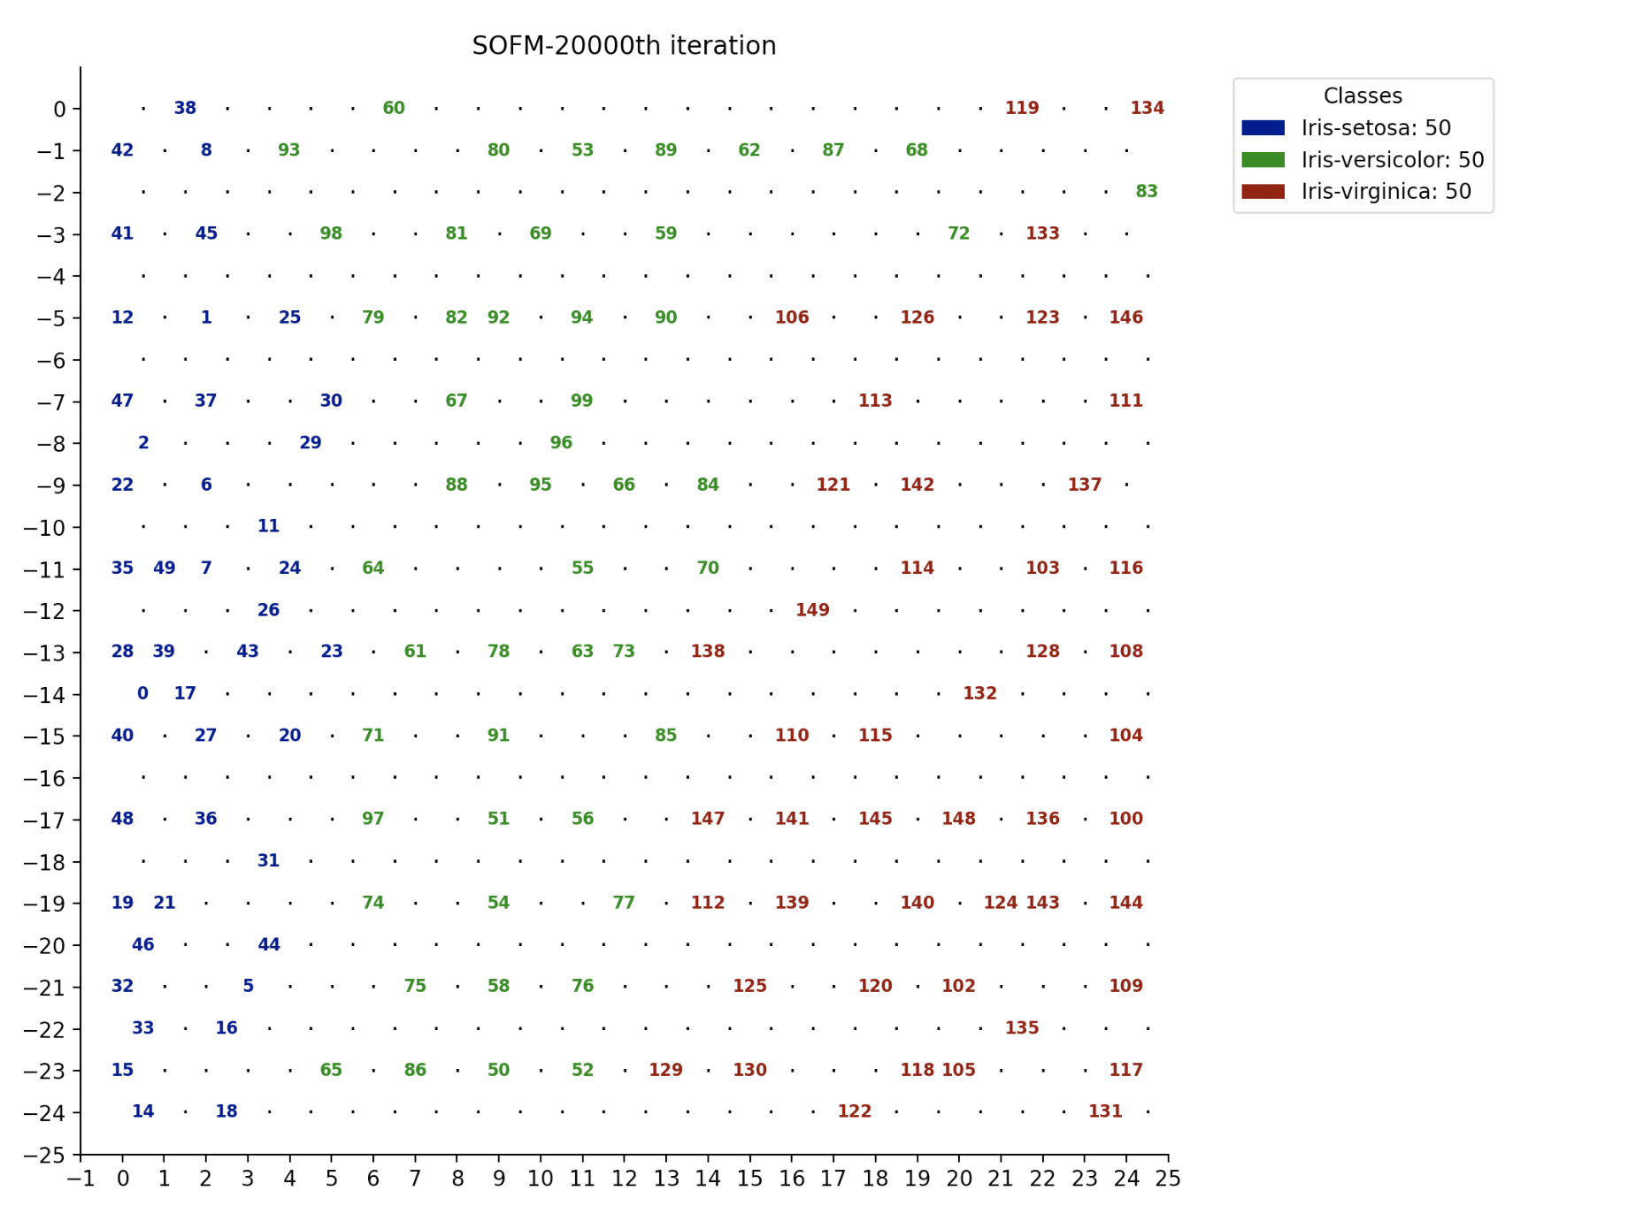
In normal usage of the SOFM algorithm, each pattern is typically assigned a label . We directly use numerical indices as labels.
It can be observed that the data retains topological structure after dimensionality reduction. At the same time, the distribution of the data aligns with the given classifications in the dataset. Data belonging to the same class are accurately clustered together.

Slide 35
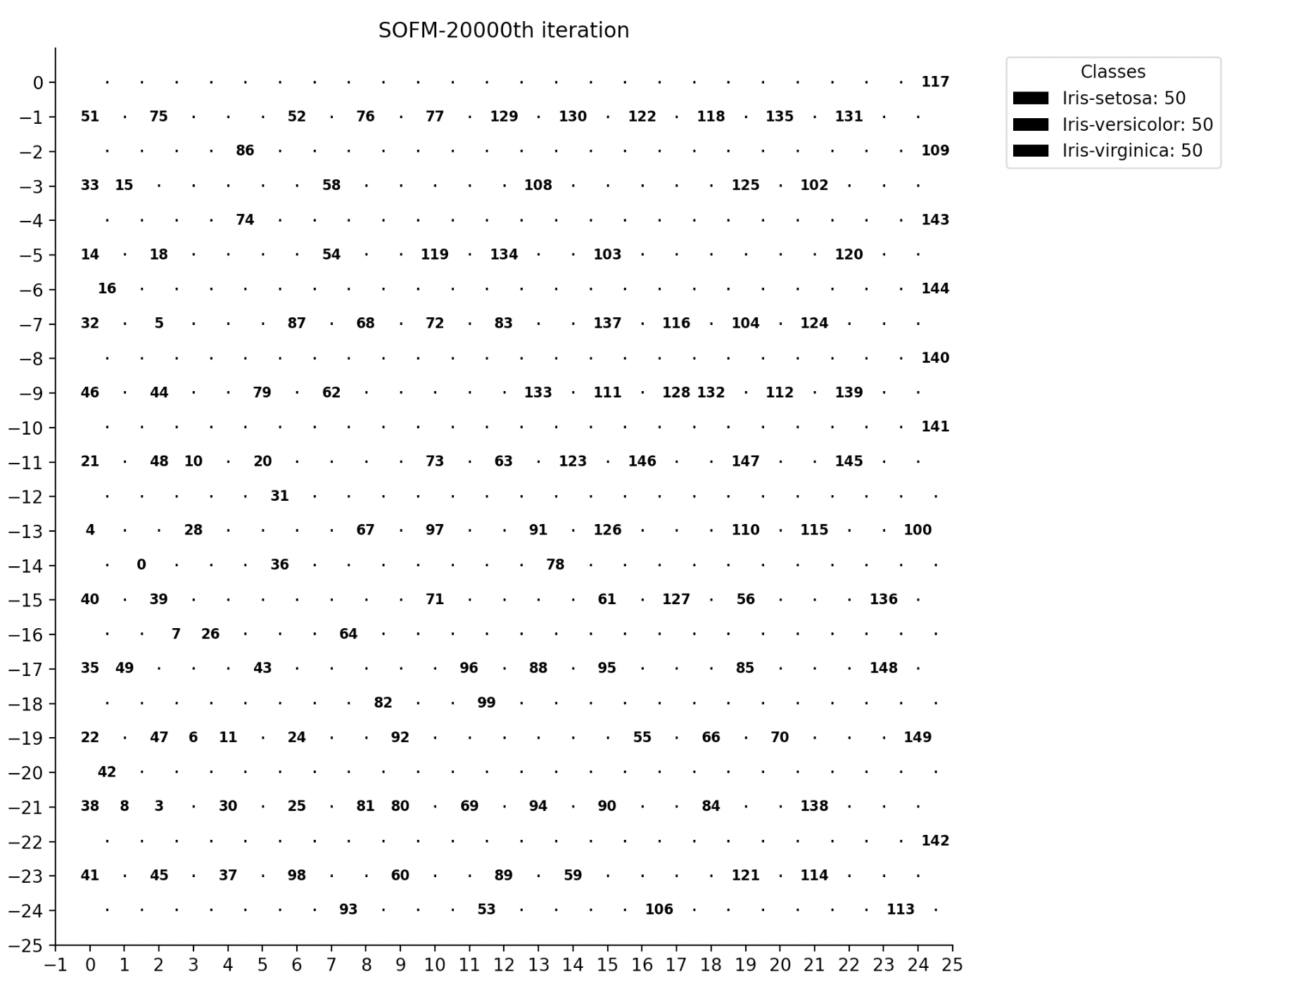
In the application scenarios of SOFM), the dataset itself usually does not have inherent classification information.
After applying the algorithm, the result is as shown in the figure.
It can be observed that although SOFM compresses the data while preserving the original data's topological structure, it cannot explicitly divide the data into different clusters. This means that we cannot find explicit clusters from the results of the SOFM algorithm.

Slide 36
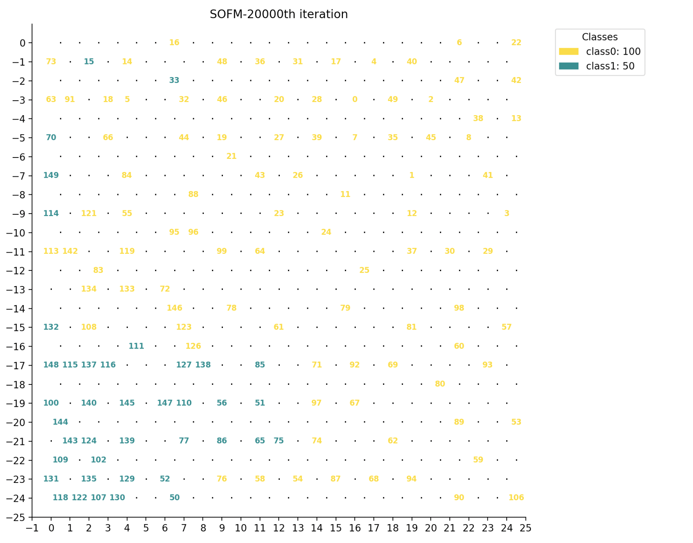
To address the above issue of preserving topological structure while achieving clustering ，we can first use the WTA algorithm to cluster the dataset. Then, we can apply the SOFM algorithm.
The result is as follows：

Slide 37
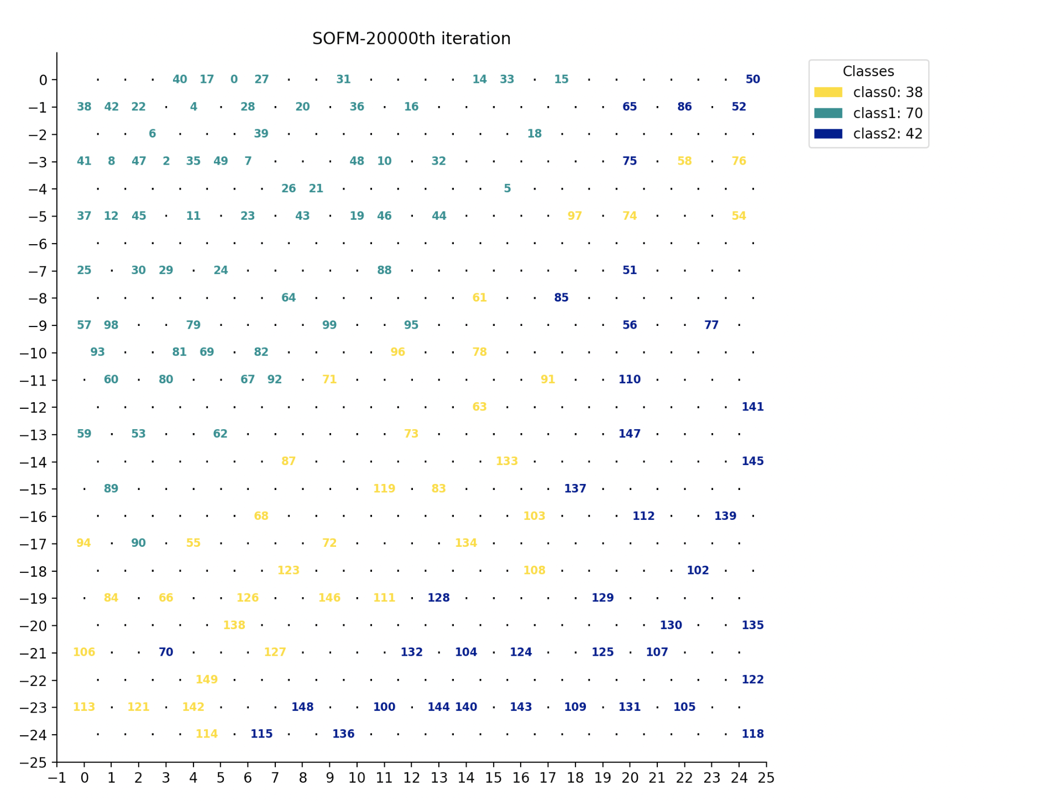

Slide 38
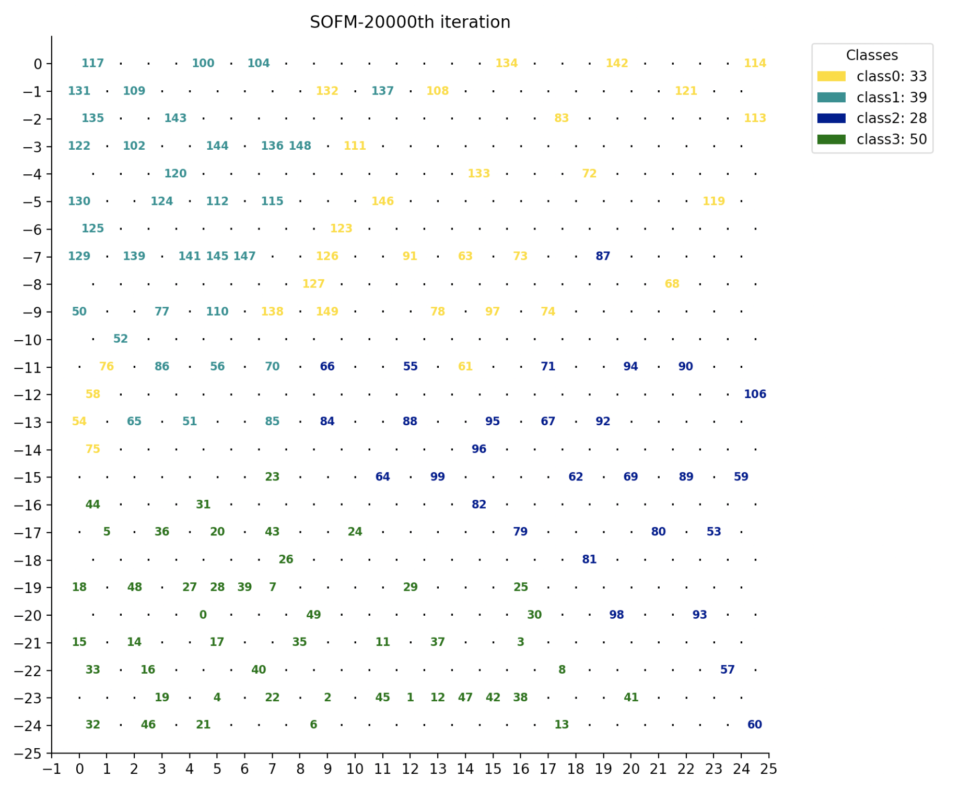

Slide 39
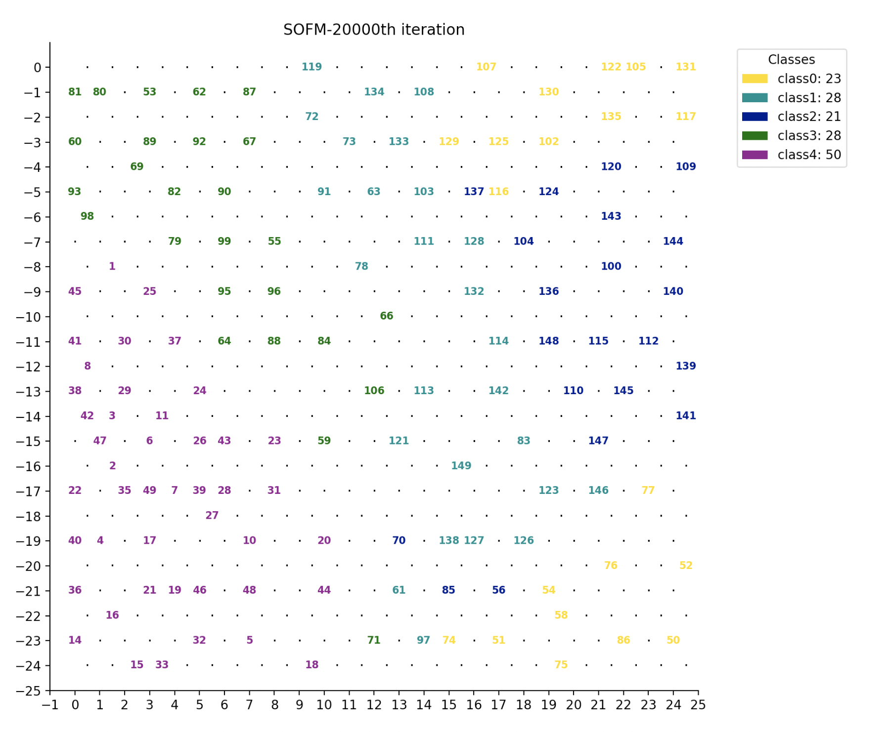
It can be observed that the clustering results are relatively accurate, with data of the same type concentrated together.
At the same time, the topological structure is also preserved.

Slide 40
We can found that the graph do not appear all 150 labels.
This is because if two patterns have the same closest neuron, they will cover each other.
But it is not a bad thing for different patterns to be assigned to the same neuron.
In practical applications, we don't always need to completely separate all the patterns.
Many times, we want to discover the overall structure of the data rather than distinguish every single data point.
By increasing the number of neurons, we may obtain a more detailed mapping that separates all the patterns, but this would significantly increase computational complexity. And the model may becoms overly focused on the details of the data while overlooking its overall structure.

Slide 41
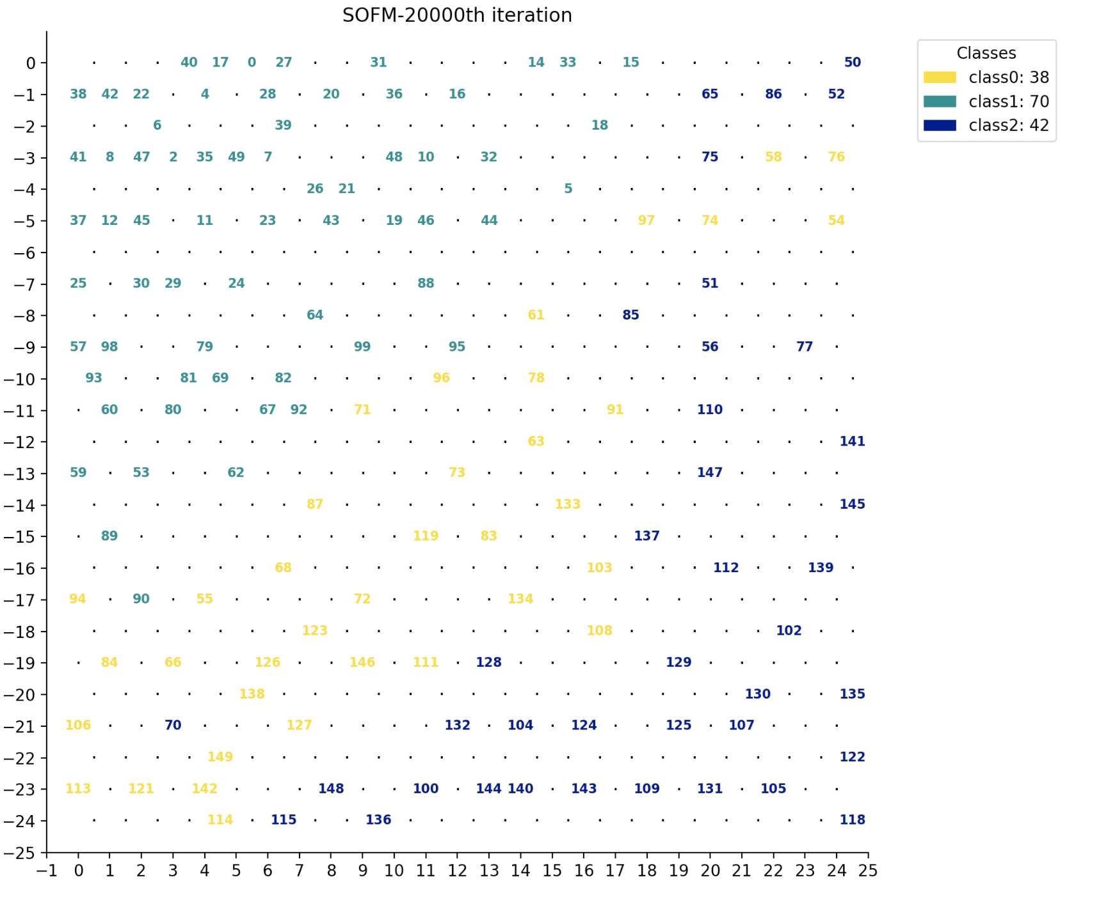
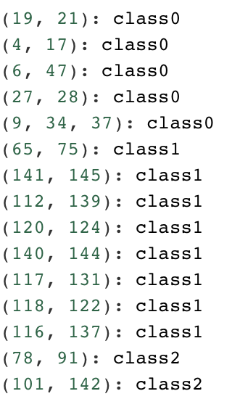
Of course, we can also take into account both the overall structure and the details. For example, we can modify the code to directly output which patterns overlap on the same neuron.
Eg.
Use "(9, 34, 37): class0" as example:
In Iris datasets:
label 9: 4.9,3.1,1.5,0.1,Iris-setosa
label 34: 4.9,3.1,1.5,0.1,Iris-setosa
label 36: 5.5,3.5,1.3,0.2,Iris-setosa
We can find that the similarity of these overlapping data is indeed very high.

Slide 42
END
July 2,2022

